Slide 1


Expressjs
from basic to middle

Slide 2
http://expressjs.com

Slide 3
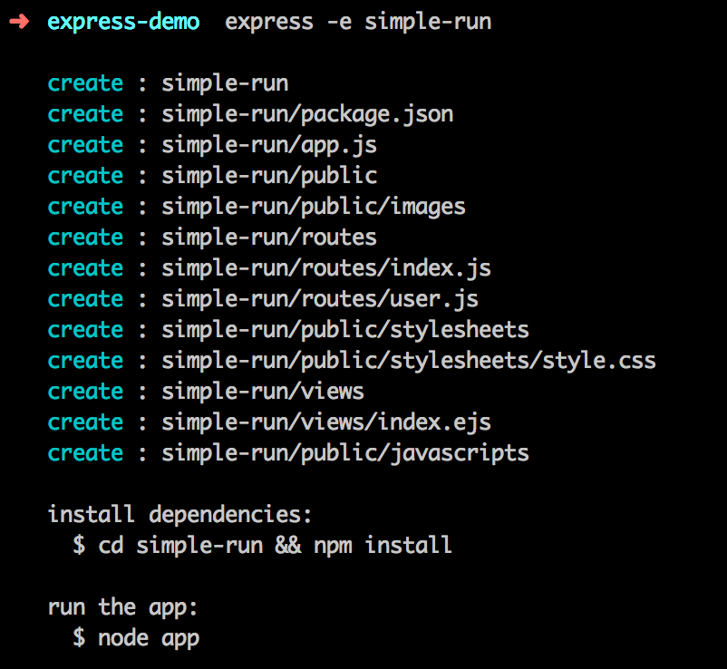
Content
folder structure

Slide 4
Content
folder structure
npm package config

Slide 5
Content
folder structure
init file (app.js)

Slide 6
Content
folder structure
static folder

Slide 7
Content
folder structure
route setting

Slide 8
Content
folder structure
view folder

Slide 9
it is basic Express folder structure

Slide 10
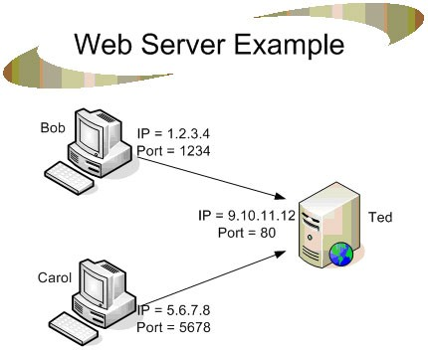
Middle
Setting in Express
app.listen

Slide 11
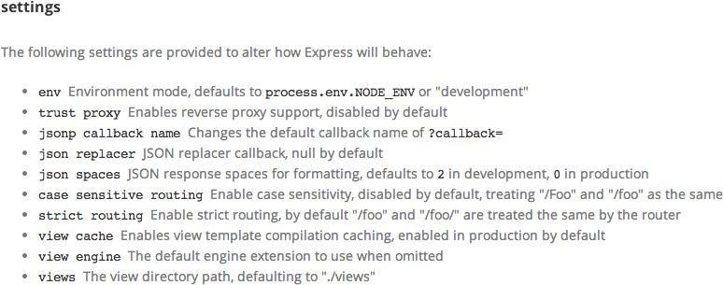
Middle
Setting in Express
app.set, app.get
app.enable, app.disable

Slide 12



Middle
Setting in Express
app.use
middleware
route
view

Slide 13
Middle
Setting in Express
app.use
middleware
app.use, will execute every route
route
view

Slide 14


Middle
Setting in Express
app.get,
app.post,
app.delete,
app.update
middleware
route
view

Slide 15
Middle
Setting in Express
app.all
app.get,
app.post,
app.delete,
app.update
middleware
route
view

Slide 16


Middle
Setting in Express
app.locals
user-data
cargo-list
cache-store
if those parameters are default

Slide 17
it is middleware
Express
app original method

Slide 18
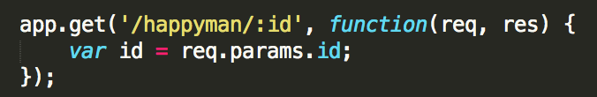
Request
req get parameter
req.params
id = 3

Slide 19
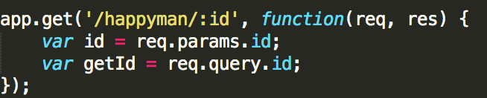
Request
req get parameter
req.query
getId = 30

Slide 20
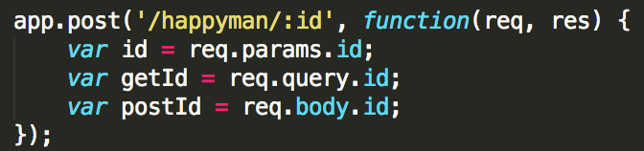
Request
req get parameter
req.body

Slide 21
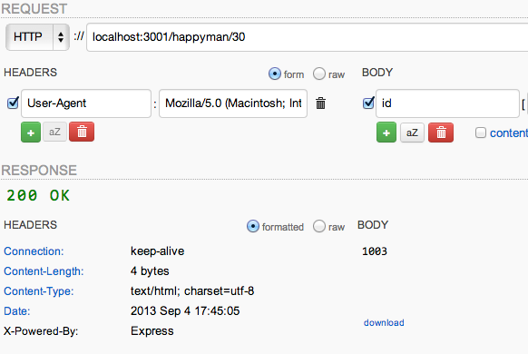
Request
req get parameter
req.body

Slide 22


Request
req get parameter
req.files

Slide 23

Request
req get cookie
req.cookies (read cookie)

Slide 24
Request
req about HEADER (read only)
req.get, req.header
req.is
req.ip, req.ips
req.host (req.subdomains)
req.protocol, (req.secure -> 'https' == req.protocol;)

Slide 25
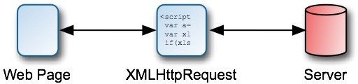
Request
req about HEADER (read only)
req.xhr

Slide 26
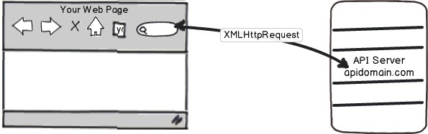
Request
req about HEADER (read only)
req.xhr

Slide 27

Request is
READ only in ExpressJS

Slide 28

Response
res about HEADER
res.status (res.statusCode)
(code only)

Slide 29

Response
res about HEADER
res.clearCookie

Slide 30
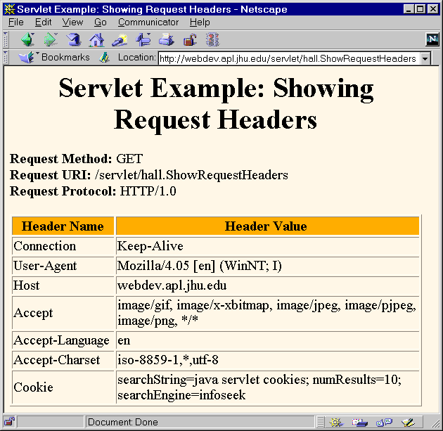
Response
res about HEADER
res.set, res.header

Slide 31

Response
res about parameters
res.locals (app.locals is different)
life cycle is only in url period.

Slide 32


Response
res client render
res.redirect

Slide 33

Response
res client render
res.json, res.send
HEADER: application/json

Slide 34
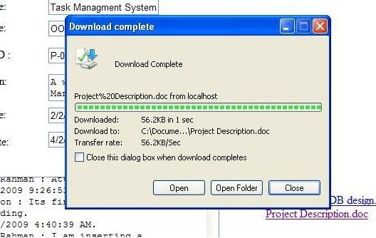
Response
res client render
res.download

Slide 35

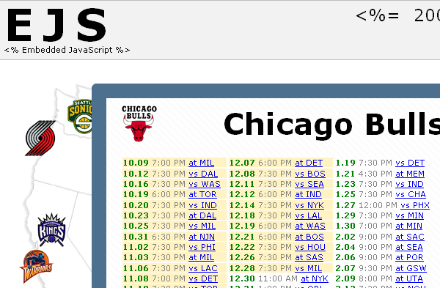
Response
res client render
res.render

Slide 36
Response write data
in Express

Slide 37
more?

Slide 38
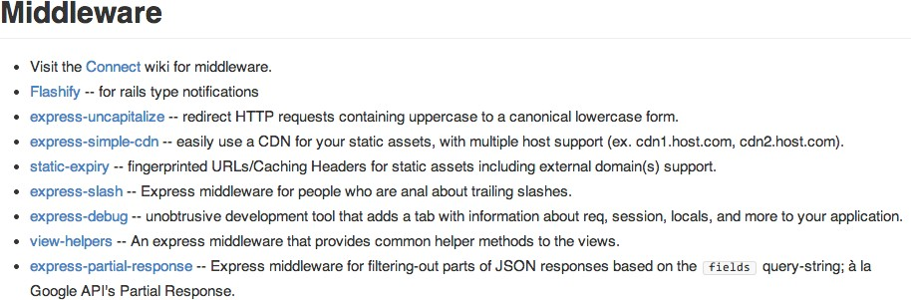
change middleware
https://github.com/visionmedia/express/wiki

Slide 39
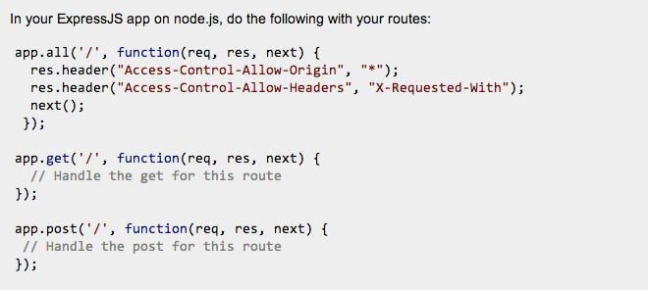
cross domain access
http://stackoverflow.com/questions/11181546/node-js-express-cross-domain-scripting

Slide 40
Q & A?

